Slide 1


Introducing ICT in a police department
Zhuravlev K. V.

Slide 2
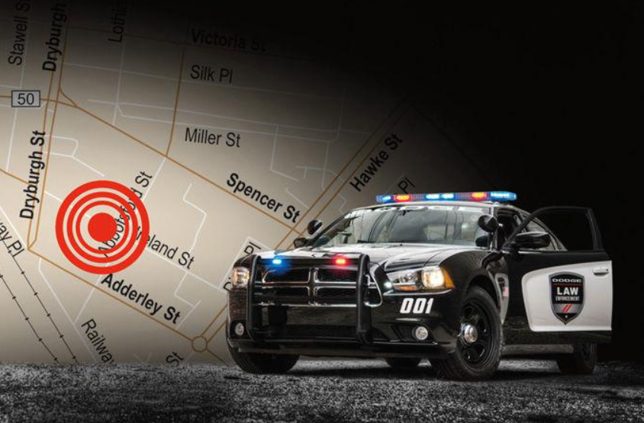


integrating SYSTEMS
DIGITAL GEO REFERENCES

Slide 3


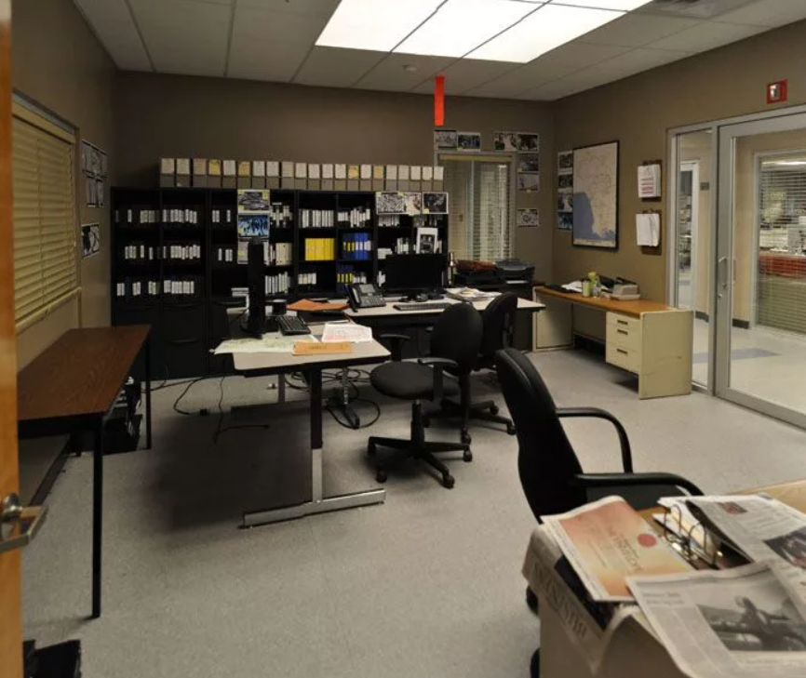
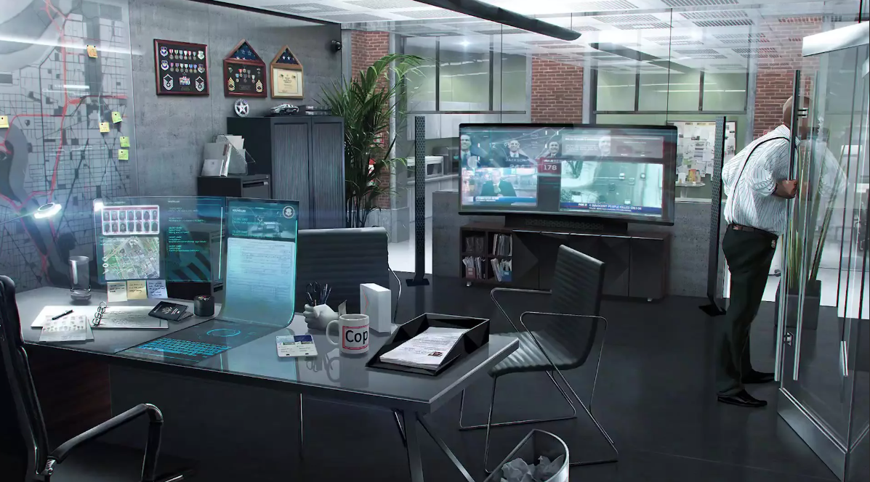
integrating SYSTEMS
BUILDING INTERFACES

Slide 4
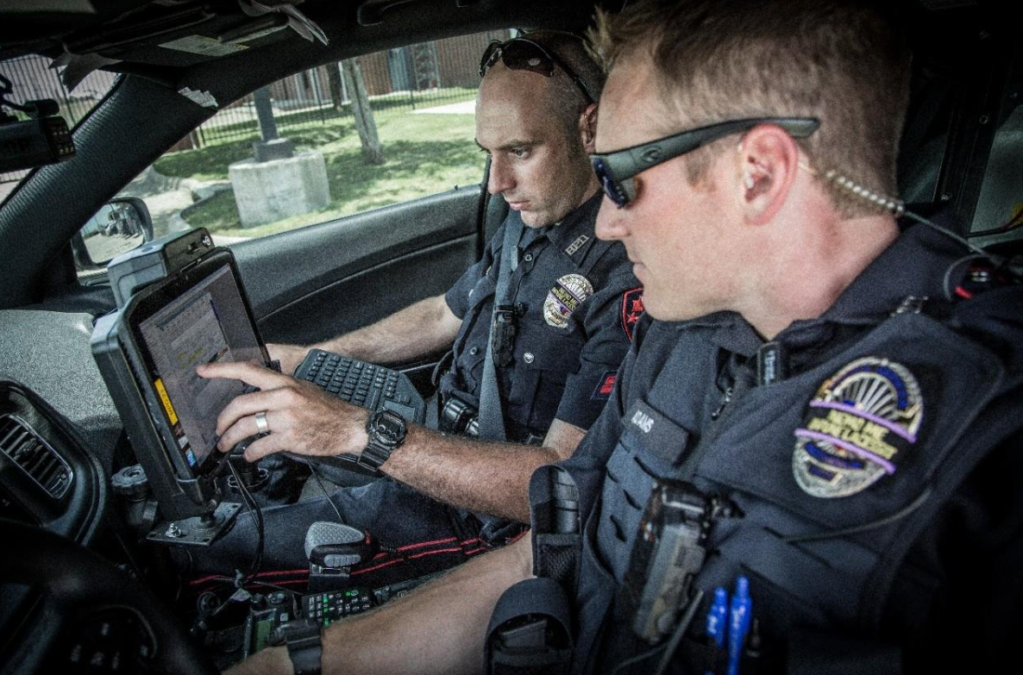
INCREASING MOBILITY
COMPUTING IN CARS

Slide 5
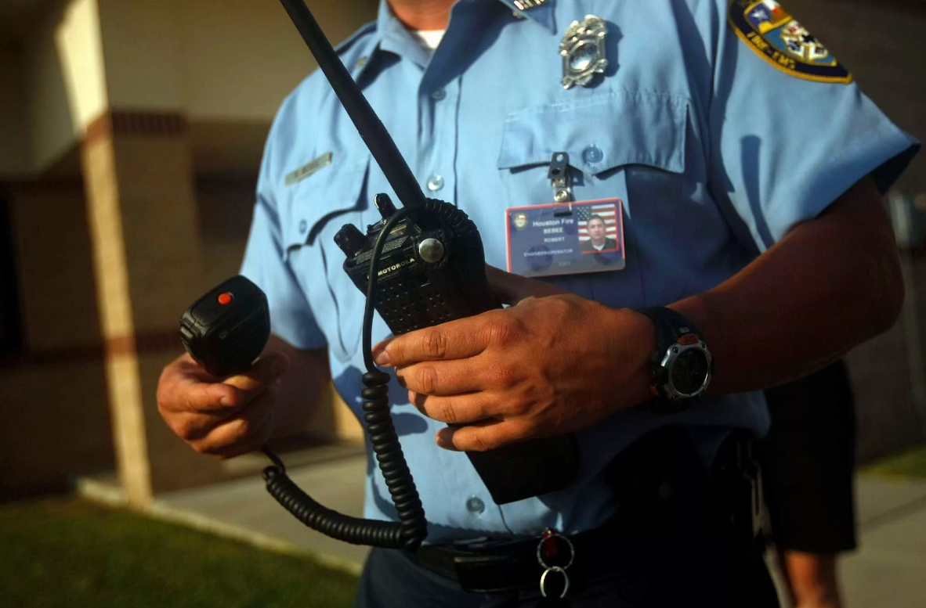

INCREASING MOBILITY
DIGITAL RADIOS

Slide 6
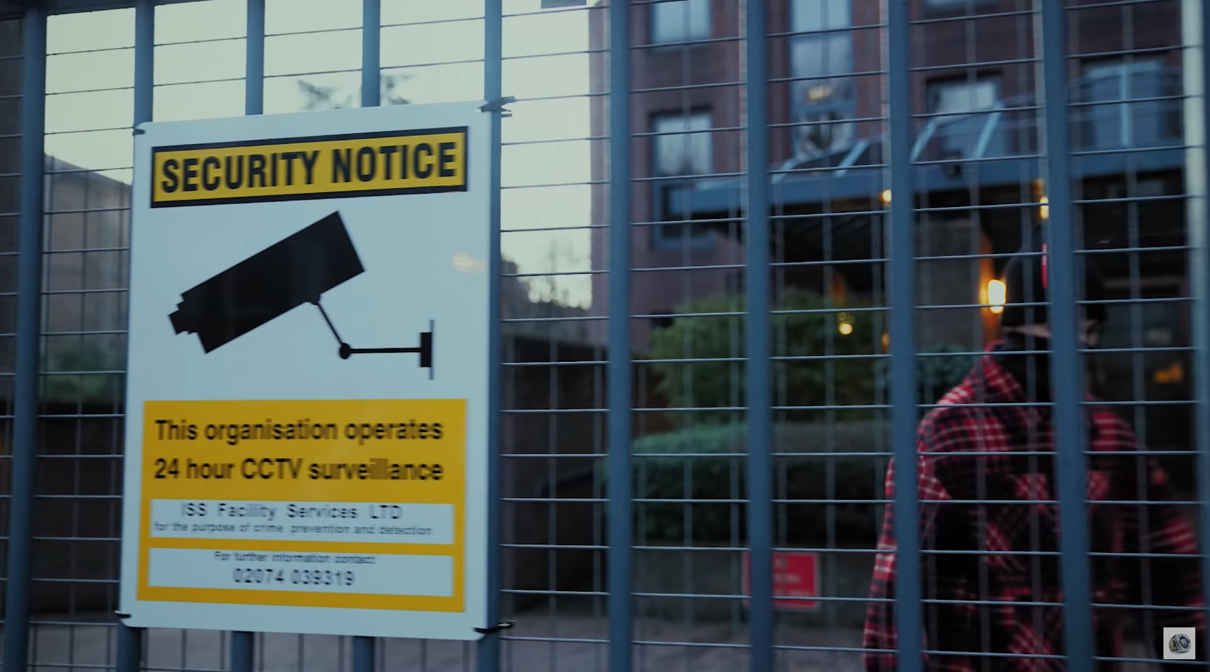
surveillance technology
OBSERVATION

Slide 7
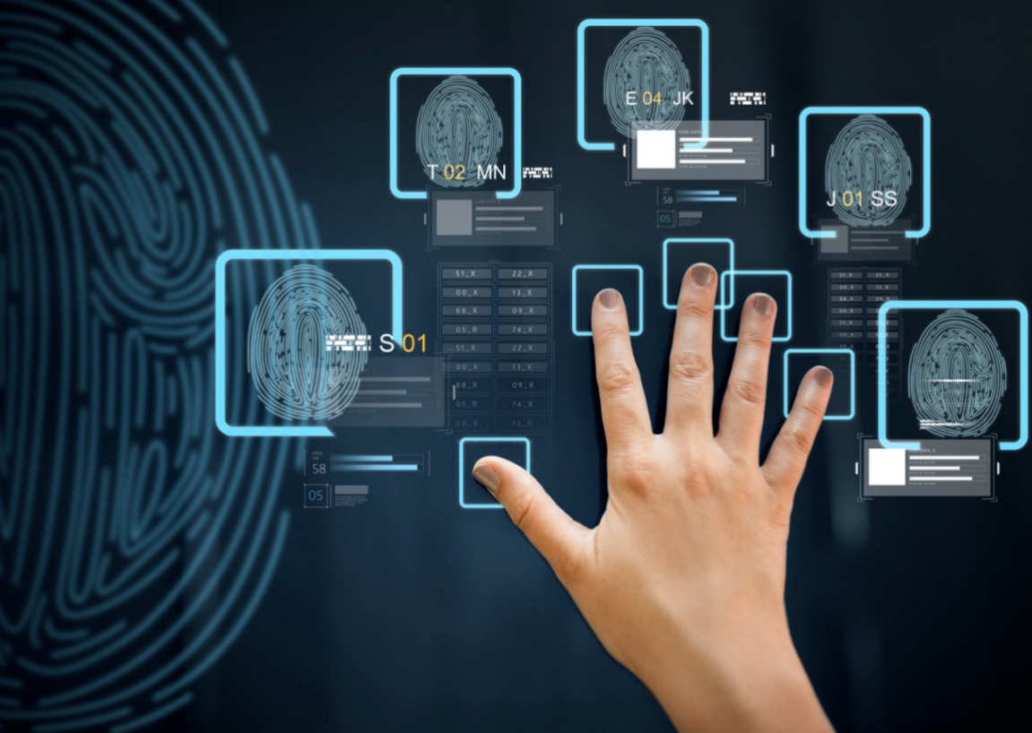
DIGITAL BIOMETRICS
FINGERPRINT SCANNERS

Slide 8
Thanks for your attention

